Slide 1

MAT205: Abstract Algebra II
1. Basics
Ma, Jia-Jun

Slide 2
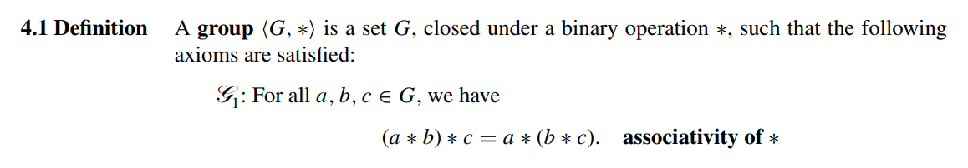
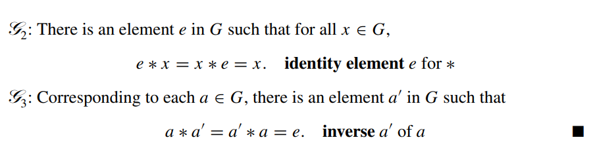

Slide 3

Examples
$\{1\}$
$(ℤ, +)$
$\left\{±1\right\}$
$ℤ/nℤ$
$S_{n}$permutation group of $n$ letters
${GL}_{n}\left(ℂ\right)$
${SL}_{n}\left(ℂ\right)$

Slide 4

Non-Examples
$\left(ℤ^{×}, ∙\right)$

Slide 5
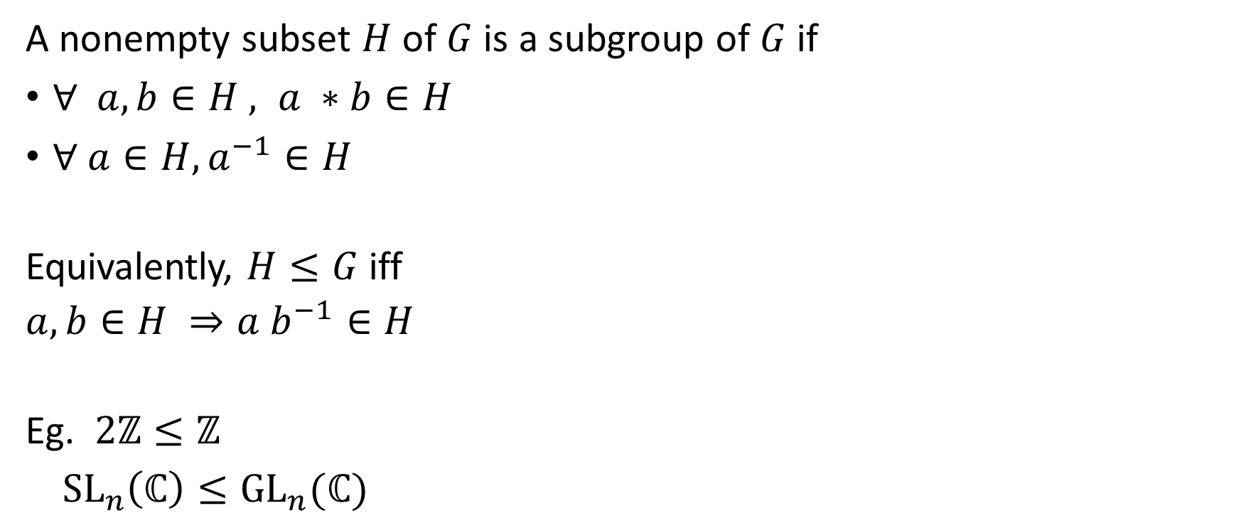
Subgroup
A nonempty subset $H$ of $G$ is a subgroup of $G$ if
$∀ a, b∈H , a ∗b∈H$
$∀ a∈H, a^{−1}∈H$
Equivalently, $H≤G$iff
$a,b∈H ⇒a b^{−1}∈H$
Eg. $2ℤ≤ℤ$
${SL}_{n}\left(ℂ\right)≤{GL}_{n}(ℂ)$

Slide 6
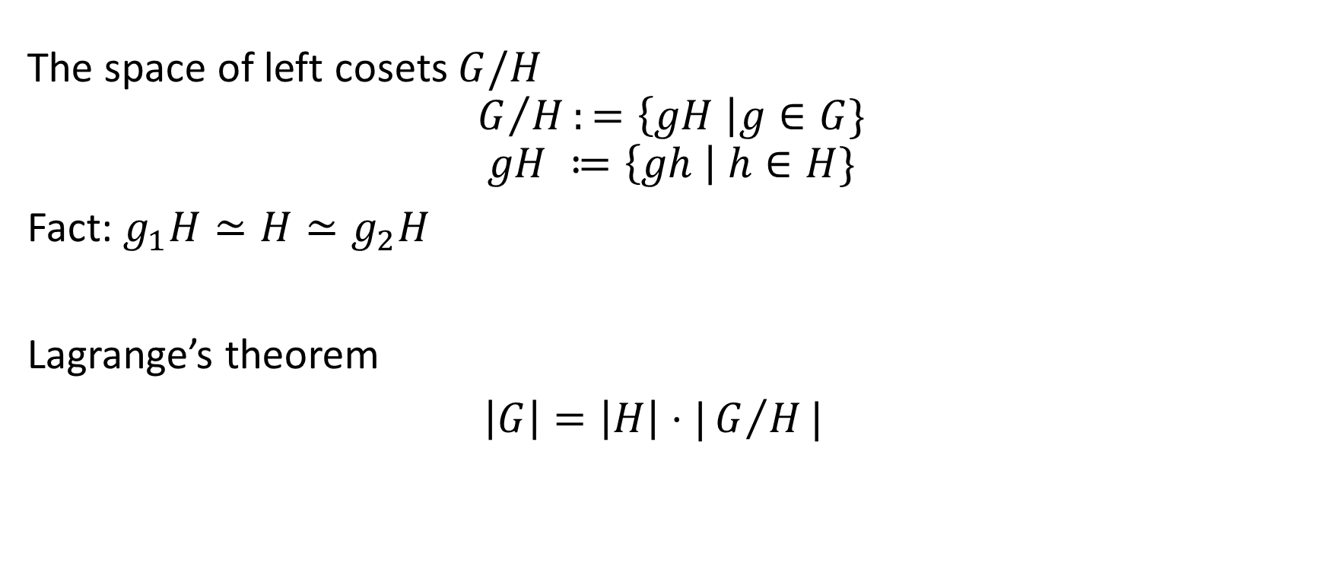

Coset space: Suppose $H<G$
The space of left cosets $G/H$
$$G/H:=\left\{gH \right|g∈G\}$$
$$gH ≔\left\{gh \right| h∈H\}$$
Fact: $g_{1}H≃H≃g_{2}H$
Lagrange’s theorem
$\left|G\right|=\left|H\right|⋅|G/H|$

Slide 7

Coset space (example)
${G= ℤ}_{6}$, $H=3 ℤ_{6}$

Slide 8

Consequence of Lagrange’s theorem
If $G$ is a finite group, $H≤G$ then $\left|H\right|$divides $|G|$.
$ℤ_{p}$ is a simple group.

Slide 9
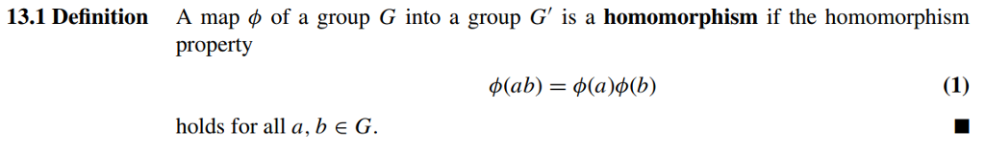
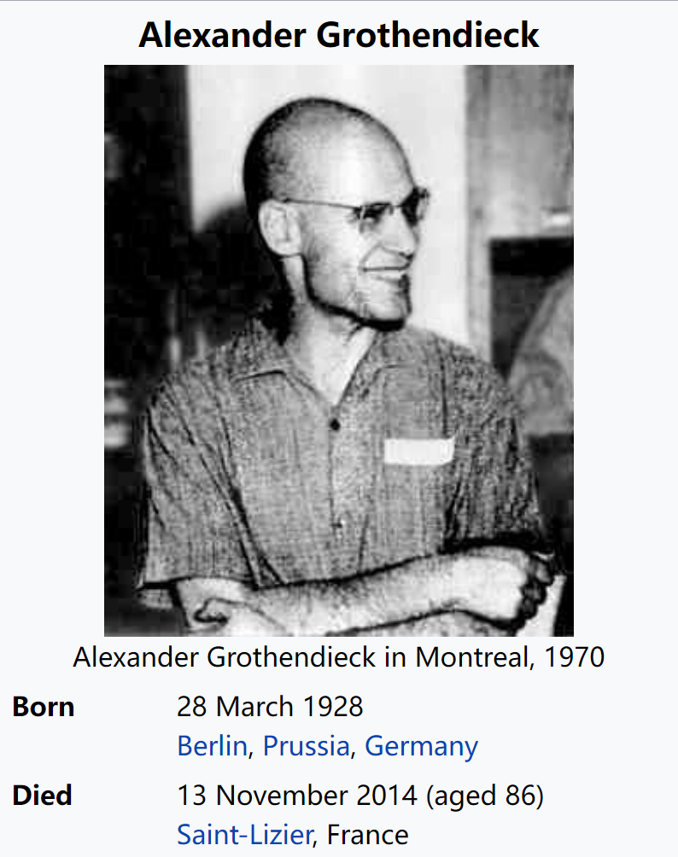

Group homomorphism
Corollary
$$φ\left(e_{G}\right)=e_{G′}$$
$φ\left(a^{−1}\right)=φ{\left(a\right)}^{−1}$
Grothendieck pointed out that
rather than analyzing objects, we should concentrate on morphisms between them.

Slide 10
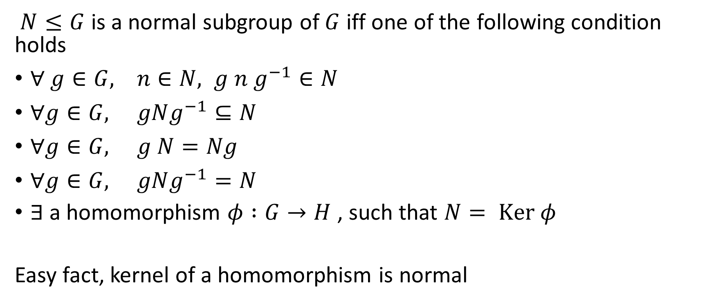
Normal subgroups
$N≤G$ is a normal subgroup of $G$ iff one of the following condition holds
$∀ g∈G, n∈N, g n g^{−1}∈N$
$∀g∈G, gNg^{−1}⊆N$
$∀g∈G, g N=Ng$
$∀g∈G, gNg^{−1}=N$
$∃$a homomorphism $φ :G→H$, such that $N= Ker φ$
Easy fact, kernel of a homomorphism is normal

Slide 11
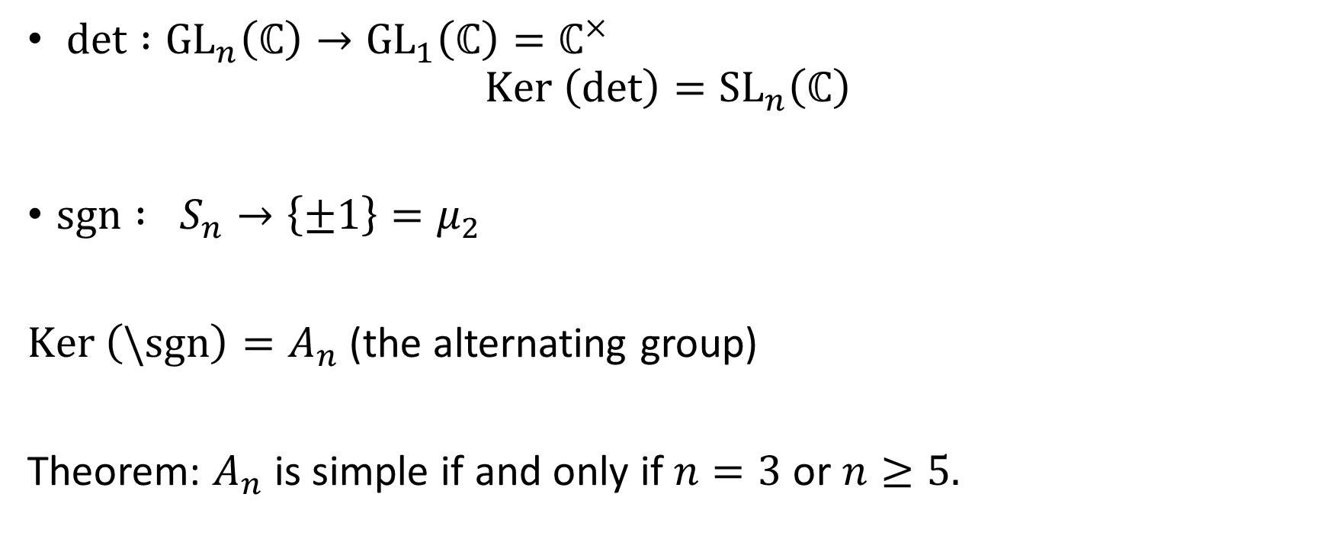
Examples
$det :{GL}_{n}\left(ℂ\right)→{GL}_{1}\left(ℂ\right)=ℂ^{×}$
$$Ker \left(det\right)={SL}_{n}\left(ℂ\right)$$
$sgn : S_{n}→\left\{±1\right\}=μ_{2}$
$Ker \left(\backslash sgn\right)=A_{n}$ (the alternating group)
Theorem: $A_{n}$ is simple if and only if $n=3$ or $n≥5.$

Slide 12

Simple group
A group $G$ is called a simple group if the trivial subgroup and $G$ are the only normal subgroups of $G$.
Question: Classify all finite abelian simple groups.

Slide 13

Quotient group
When $N⊲G$, the coset space $G/N$ has a natural group structure.
$$\left(g_{1}N\right)⋅\left(g_{2}N\right)≔{(g}_{1}g_{2})N$$
Check the product is well defined.

Slide 14

Example
$ℤ_{n}= ℤ/nℤ$
${PGL}_{n}\left(ℂ\right)≔{{GL}_{n}\left(ℂ\right)}/Z$, where $Z$ is the subgroup of invertible diagonal matrices.

Slide 15
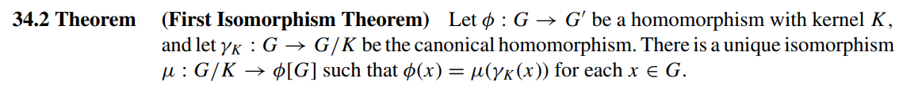
Homomorphism Theorem
The commutative diagram.

Slide 16









The general from: universal property of the quotient group
Suppose $N⊲G$. Any morphism $φ :G→H$ such that $N≤Ker φ$ factor through $G/N$.
The diagram
$$π$$
$$N$$
$$G$$
$$G/N$$
$$φ$$
$$\overline{φ}$$
$$1$$
$$H$$

Slide 17

Define quotient group by universal property
Assume $N⊲G$. A quotient group of $G$ by $N$ is a pair $(Q, γ :G→Q)$ then $∃!\overline{φ}:Q→H$ satisfying $φ=\overline{φ}∘γ.$
Eg. $G=ℤ$, $N=2ℤ$

Slide 18

Second Isomorphism Theorem
$$N/{H∩N}{\underset{→}{ ≅ }HN}/N$$

Slide 19


Normalizer $K≤G$
$$N_{G}\left(K\right)≔\left\{g∈G \right| gKg^{-1}=K\}$$
Lemma: $HK≔\left\{hk \right|h∈H, k∈K\}$ is a subgroup of $G$ if and only if $H≤N_{G}\left(K\right)$.

Slide 20
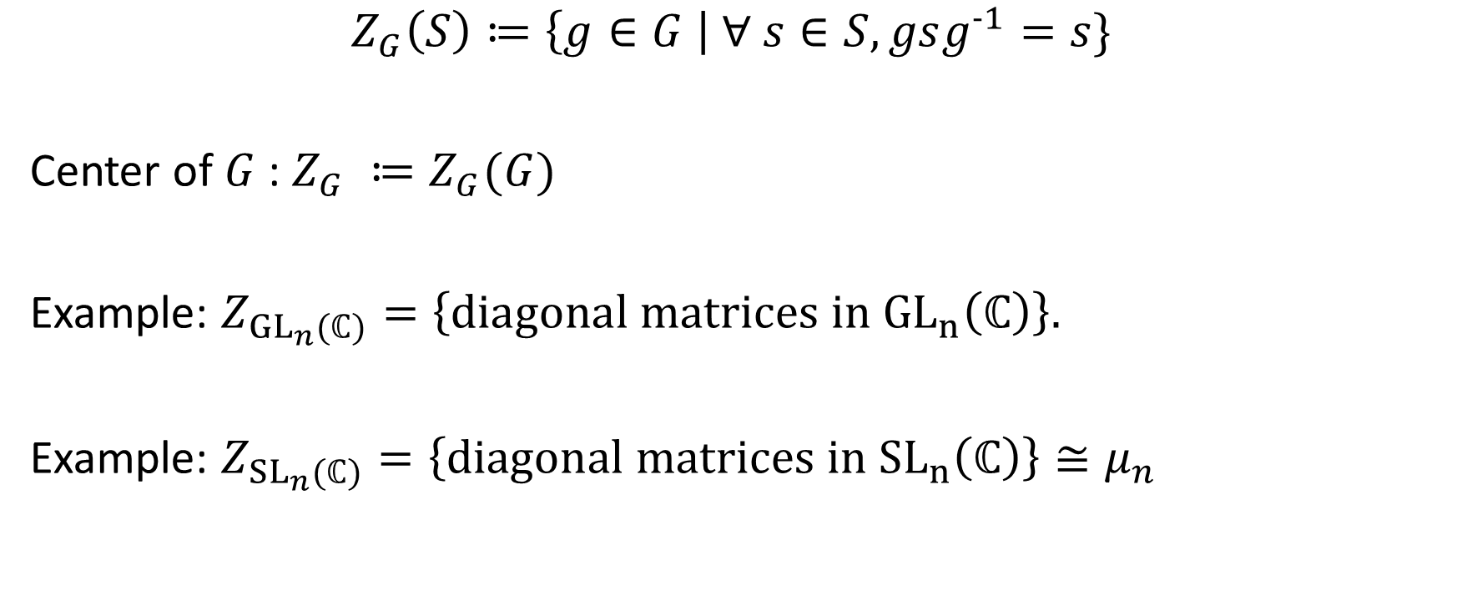

Centralizer of $S⊆G$
$$Z_{G}\left(S\right)≔\left\{g∈G \right| ∀ s∈S, gsg^{-1}=s\}$$
Center of $G$ : $Z_{G} ≔Z_{G}(G)$
Example: $Z_{{GL}_{n}(ℂ)}=\left\{diagonal matrices in {GL}_{n}\left(ℂ\right)\right\}.$
Example: $Z_{{SL}_{n}(ℂ)}=\left\{diagonal matrices in {SL}_{n}\left(ℂ\right)\right\}≅μ_{n}$

Slide 21

Example of second isomorphism theorem
$${{SL}_{n}\left(ℂ\right)}/{μ_{n}}≅{{GL}_{n}\left(ℂ\right)}/{Z_{{GL}_{n}(ℂ)}}$$

Slide 22
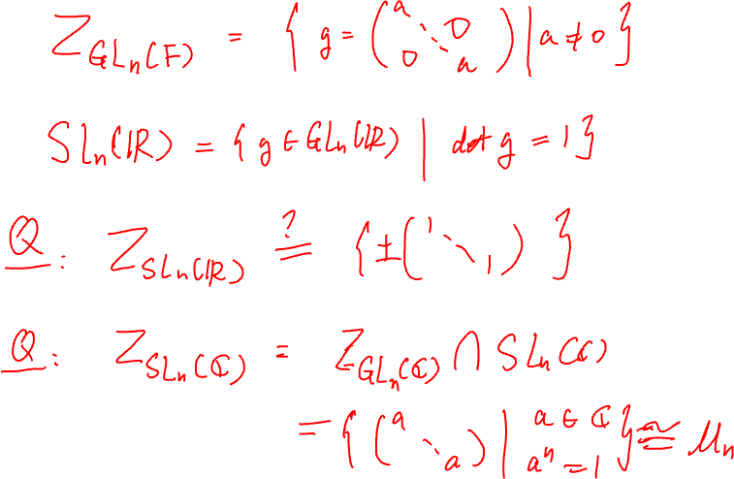
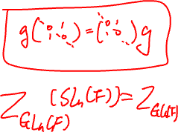

Slide 23
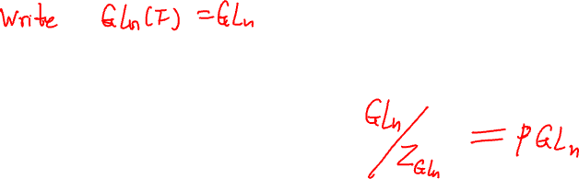
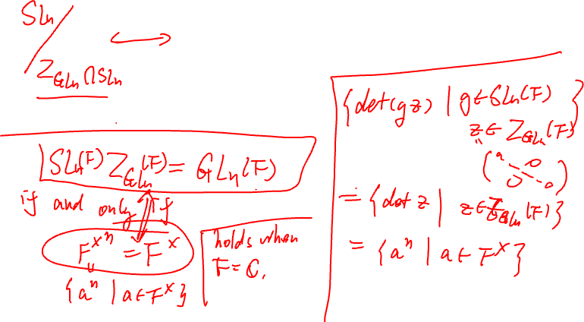

Slide 24
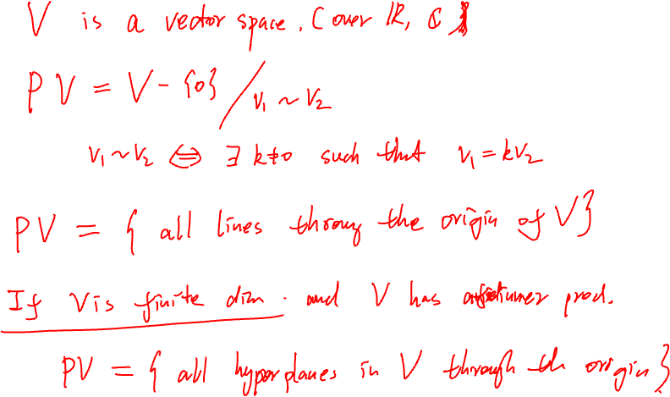

Slide 25
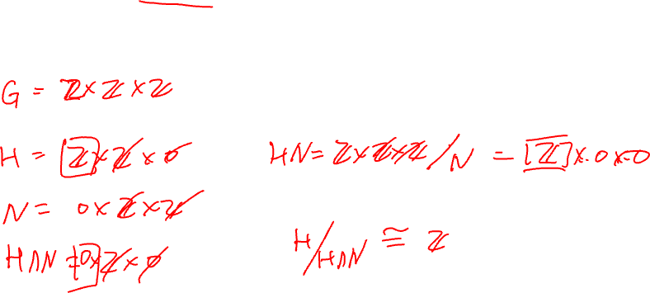

Slide 26
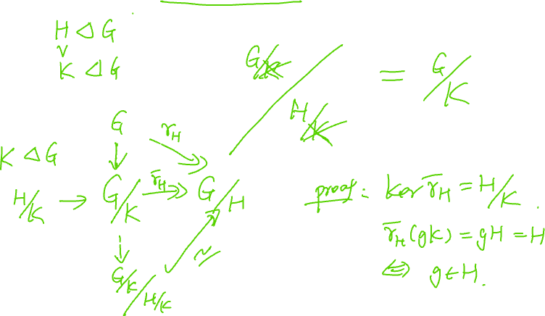

Slide 27
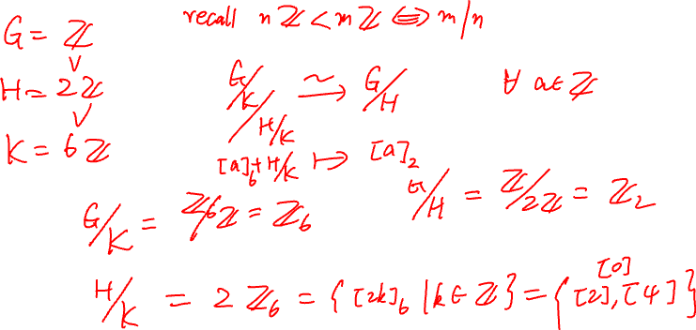

Slide 28
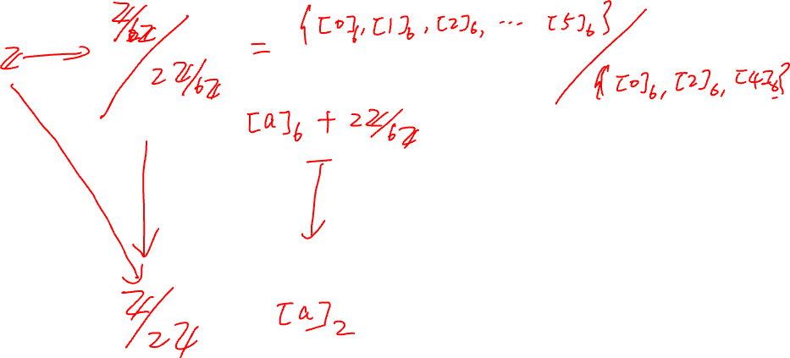

Slide 29


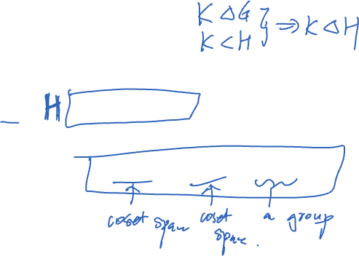
Question:
Suppose $K⊲H, K<H<G$.
Is the following equation make sence?
$G/H≅(G/K)/(H/K)$

Slide 30
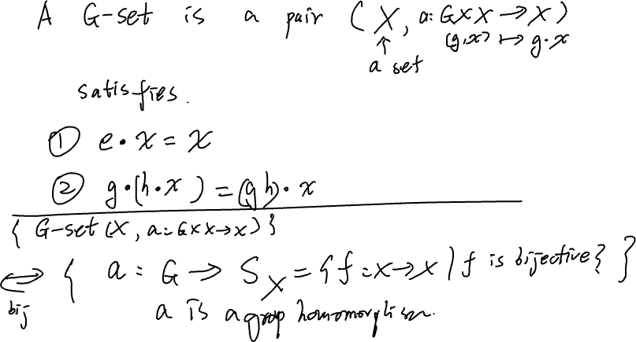


Slide 31
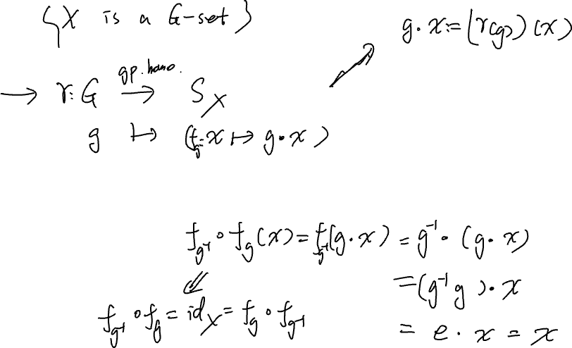

Slide 32
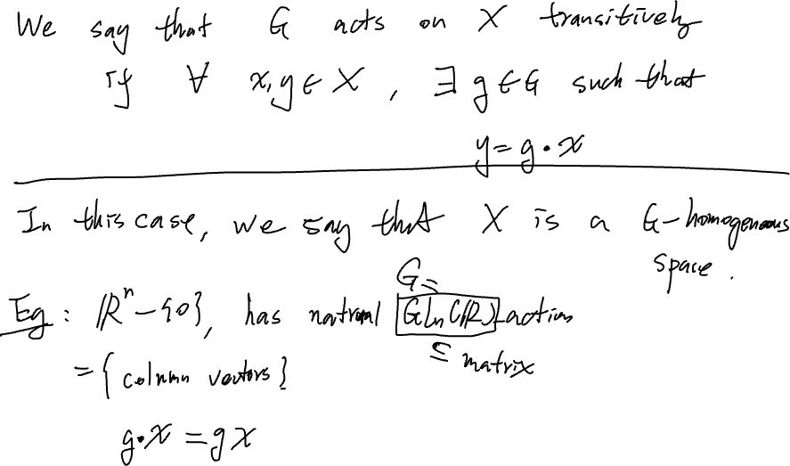

Slide 33
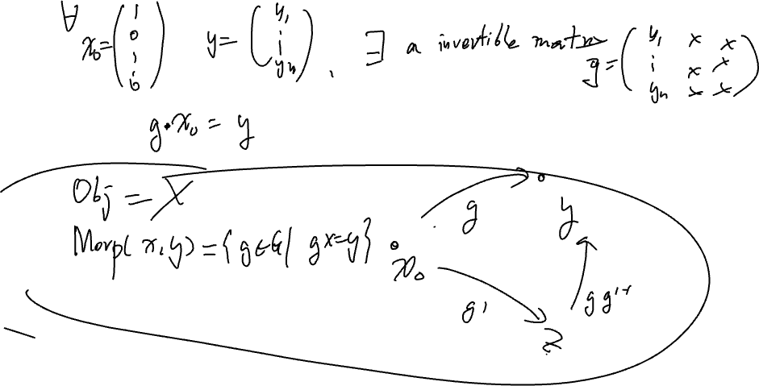
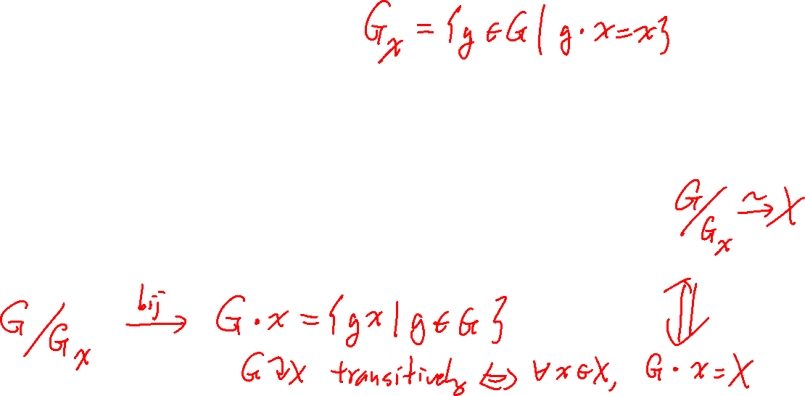

Slide 34
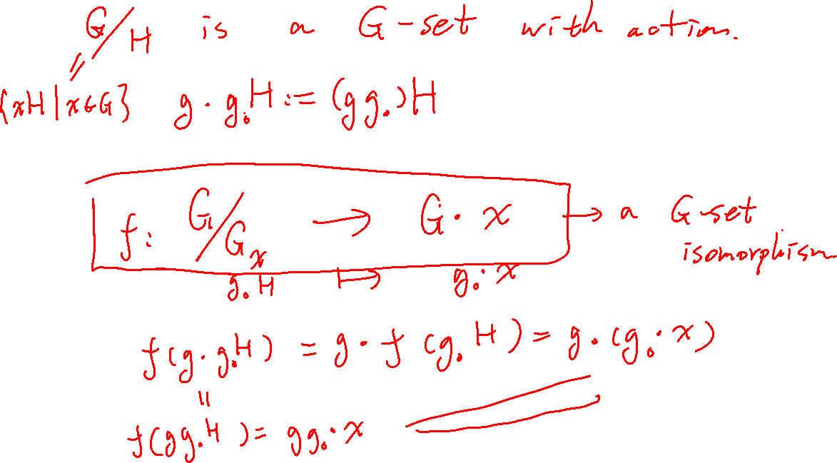

Slide 35


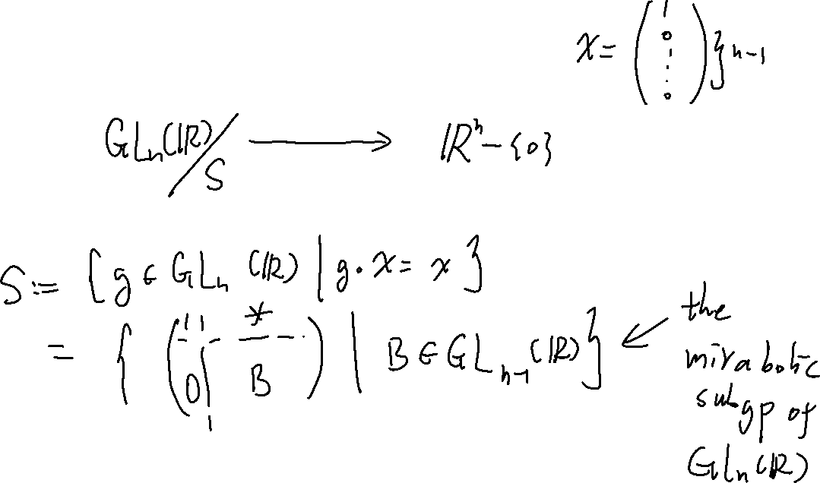
Example: $ℝ^{n}−\left\{0\right\}→{ℝℙ}^{n−1}$

Slide 36
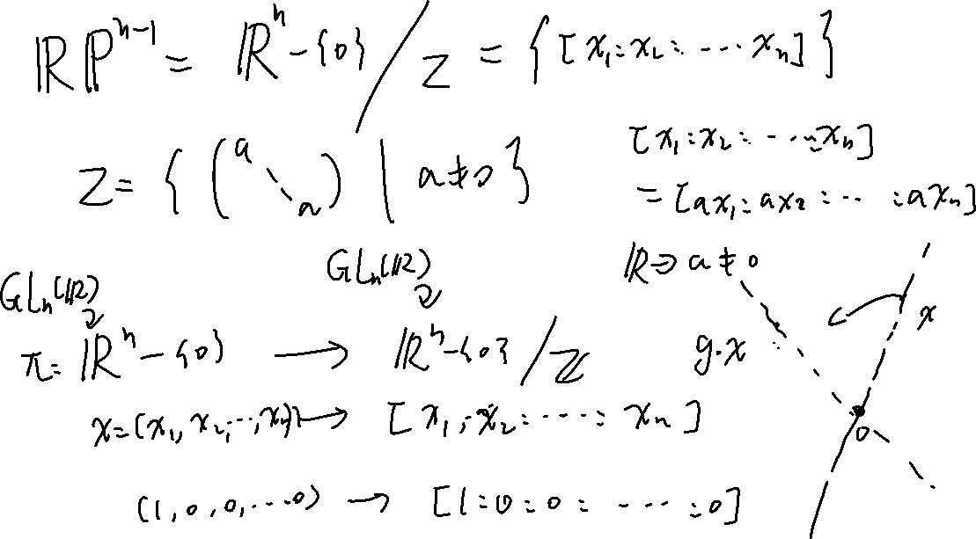

Slide 37
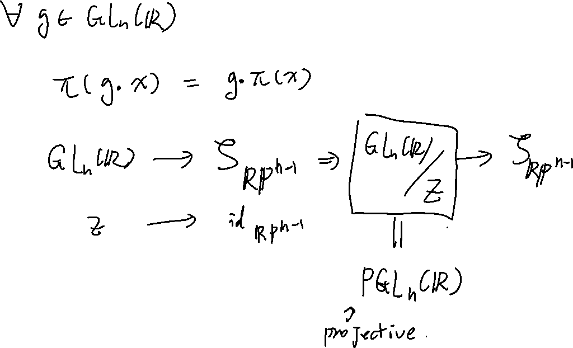

Slide 38
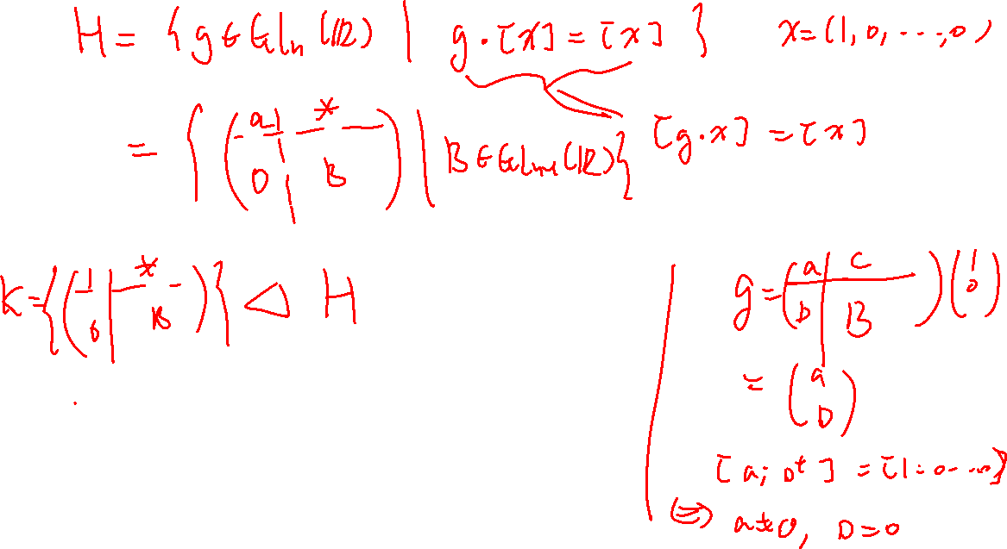

Slide 39
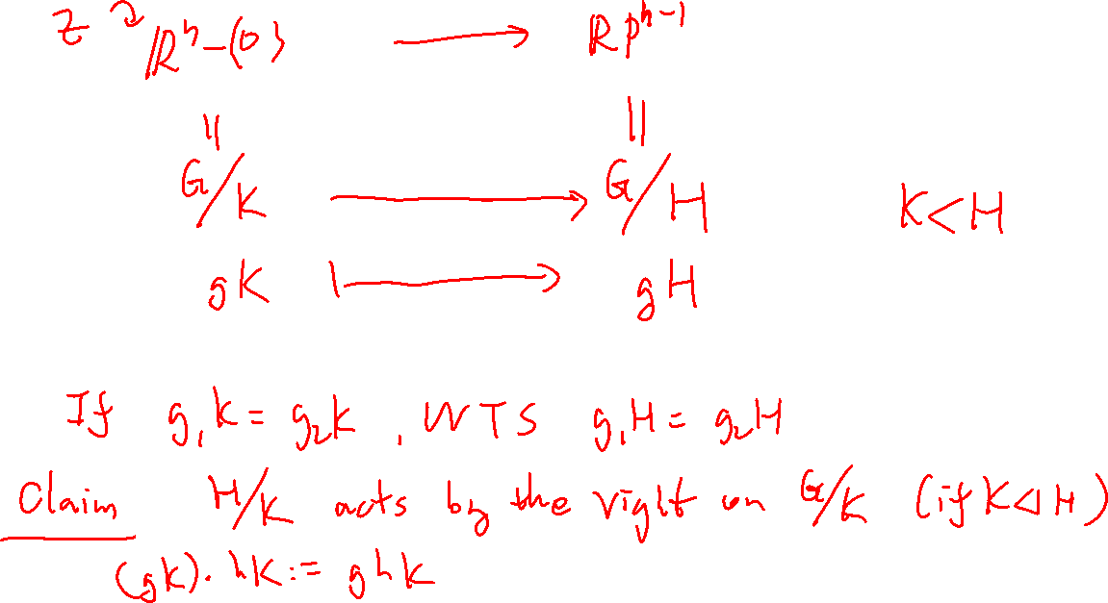


Slide 40
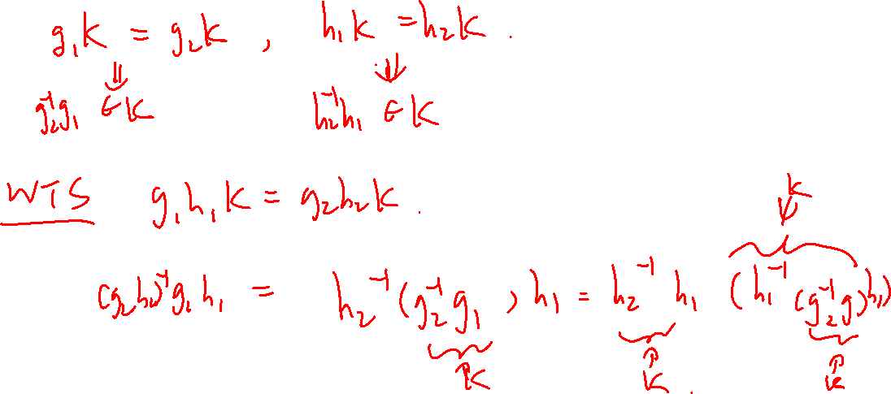
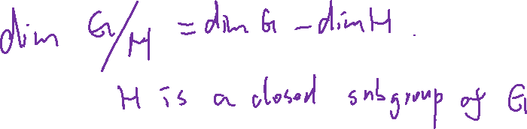

Slide 41
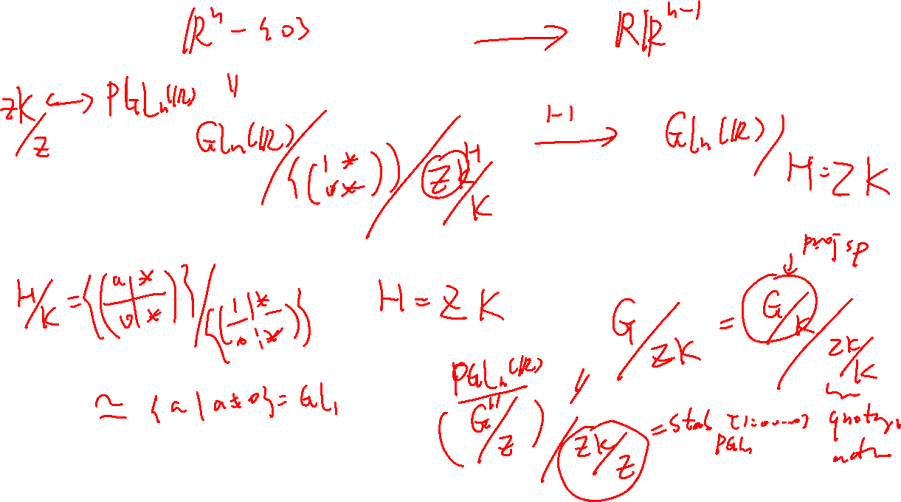

Slide 42
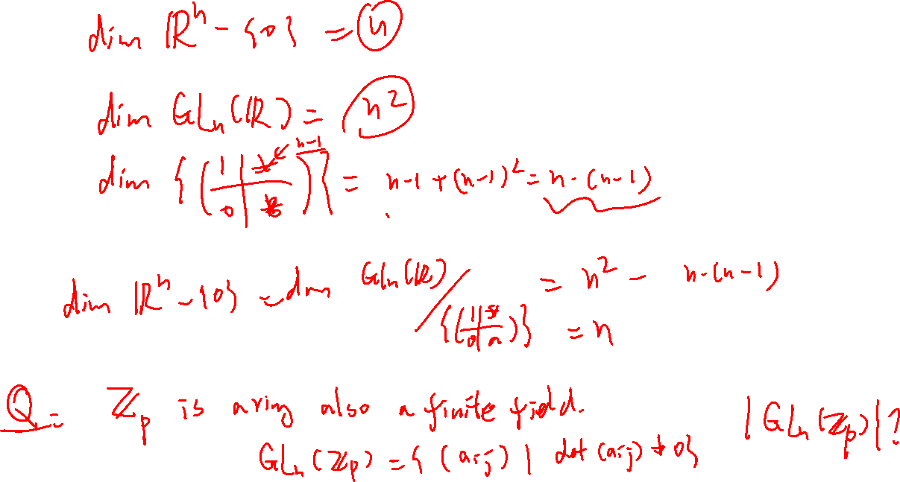

Slide 43


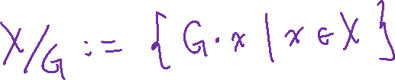
Counting (Burnside’s lemma)
Lemma: Let $G$ be a finite group an $X$ be a finite $G$-set. Then
$$\left|X/G\right|=\frac{1}{|G|} \sum_{g∈G}{|X^{g}|}.$$
Here $X^{g}≔\left\{x∈X \right|g⋅x=x\}.$

Slide 44
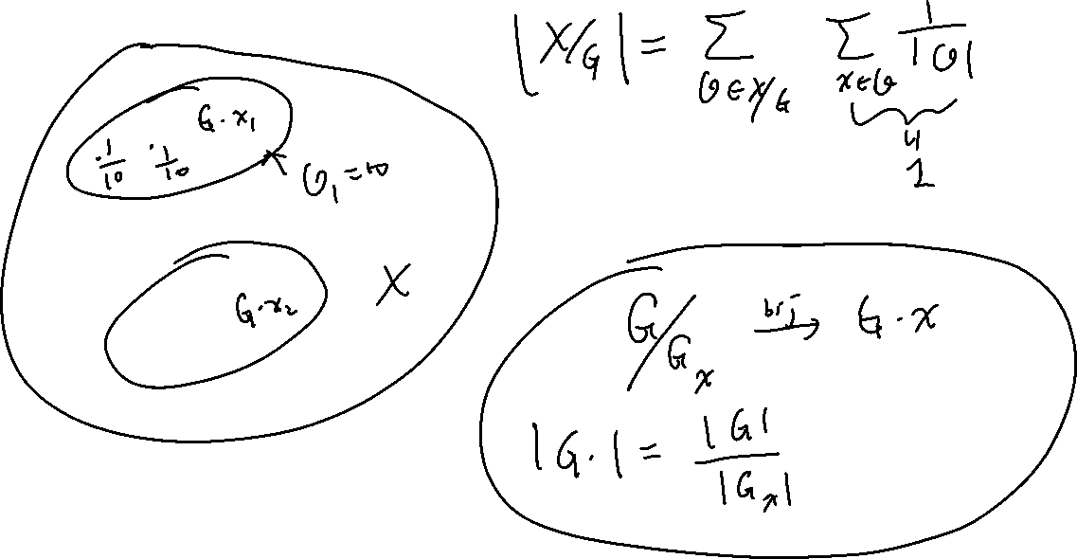

Slide 45


Slide 46

Application
How many distinct neckleces with 7 beads are there made by beads of 2-different colors (say bule and red)

Slide 47


Slide 48


Slide 49


Slide 50


Slide 51


